Slide 1

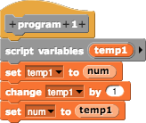


Race Condition Example
We have two programs, program 1 and program 2, and a global variable ‘num’. Ideally, we want the script in program 1 to run before the script in program 2, but this won’t always be the case. We’ll look at two scenarios, the first where they run in order (serial), and the second where they don’t (race condition).

Slide 2
Serial - Example
 |  | (Global Integer Value)
 |  | 0
‘num’ starts out with value 0

Slide 3
Serial - Example
 |  | (Global Integer Value)
 |  | 0
 |  | 0
read value
(reads the value of ‘num’, and sets ‘temp1’ to that value)

Slide 4
Serial - Example
 |  | (Global Integer Value)
 |  | 0
 |  | 0
 |  | 0
increments value
(increases the value of ‘temp1’ by 1)

Slide 5
Serial - Example
 |  | (Global Integer Value)
 |  | 0
 |  | 0
 |  | 0
 |  | 1
sets value
(sets ‘num’ to the value of ‘temp1’, which is 1)

Slide 6
Serial - Example
 |  | (Global Integer Value)
 |  | 0
 |  | 0
 |  | 0
 |  | 1
 |  | 1
read value
(reads the value of ‘num’, and sets ‘temp2’ to that value)

Slide 7
Serial - Example
 |  | (Global Integer Value)
 |  | 0
 |  | 0
 |  | 0
 |  | 1
 |  | 1
 |  | 1
increments value
(increases the value of ‘temp2’ by 2)

Slide 8
Serial - Example
 |  | (Global Integer Value)
 |  | 0
 |  | 0
 |  | 0
 |  | 1
 |  | 1
 |  | 1
 |  | 3
sets value
(sets ‘num’ to the value of ‘temp2’, which is 3)

Slide 9
Serial - Example
 |  | (Global Integer Value)
 |  | 0
 |  | 0
 |  | 0
 |  | 1
 |  | 1
 |  | 1
 |  | 3
This is the expected output. We’re good here!

Slide 10
What if we interleaved the commands?

Slide 11
Race Condition - Example
 |  | (Global Integer Value)
 |  | 0
‘num’ starts out with value 0

Slide 12
Race Condition - Example
 |  | (Global Integer Value)
 |  | 0
 |  | 0
read value
(reads the value of ‘num’, and sets ‘temp1’ to that value)

Slide 13
Race Condition - Example
 |  | (Global Integer Value)
 |  | 0
 |  | 0
 |  | 0
read value
(reads the value of ‘num’, and sets ‘temp2’ to that value)

Slide 14
Race Condition - Example
 |  | (Global Integer Value)
 |  | 0
 |  | 0
 |  | 0
 |  | 0
 |  | 0
increments value
(increases the value of ‘temp2’ by 2)

Slide 15
Race Condition - Example
 |  | (Global Integer Value)
 |  | 0
 |  | 0
 |  | 0
 |  | 0
increments value
(increases the value of ‘temp1’ by 1)

Slide 16
Race Condition - Example
 |  | (Global Integer Value)
 |  | 0
 |  | 0
 |  | 0
 |  | 0
 |  | 0
 |  | 1
sets value
(sets ‘num’ to the value of ‘temp1’, which is 1)

Slide 17
Race Condition - Example
 |  | (Global Integer Value)
 |  | 0
 |  | 0
 |  | 0
 |  | 0
 |  | 0
 |  | 1
 |  | 2
sets value
(sets ‘num’ to the value of ‘temp2’, which is 2)

Slide 18
Race Condition - Example
 |  | (Global Integer Value)
 |  | 0
 |  | 0
 |  | 0
 |  | 0
 |  | 0
 |  | 1
 |  | 2
This is the NOT the expected output. ‘num’ is only 2!

Slide 19
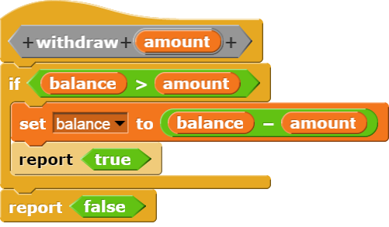
Race Condition Example: Withdrawing
What if two people were calling withdraw at the same time?
e.g., balance = 100 and two withdrew 75 each
Can anyone see what the problem could be?
This is a race condition.
In most languages, this is a problem.
In Scratch, the system doesn’t let two of these run at once.

Slide 20
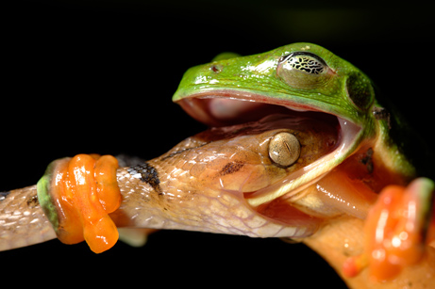
Deadlock Example
Notes:
According to photographer, locked like this for 3 hours. he didn’t stick around to see who won…
Article can be found here

Slide 21
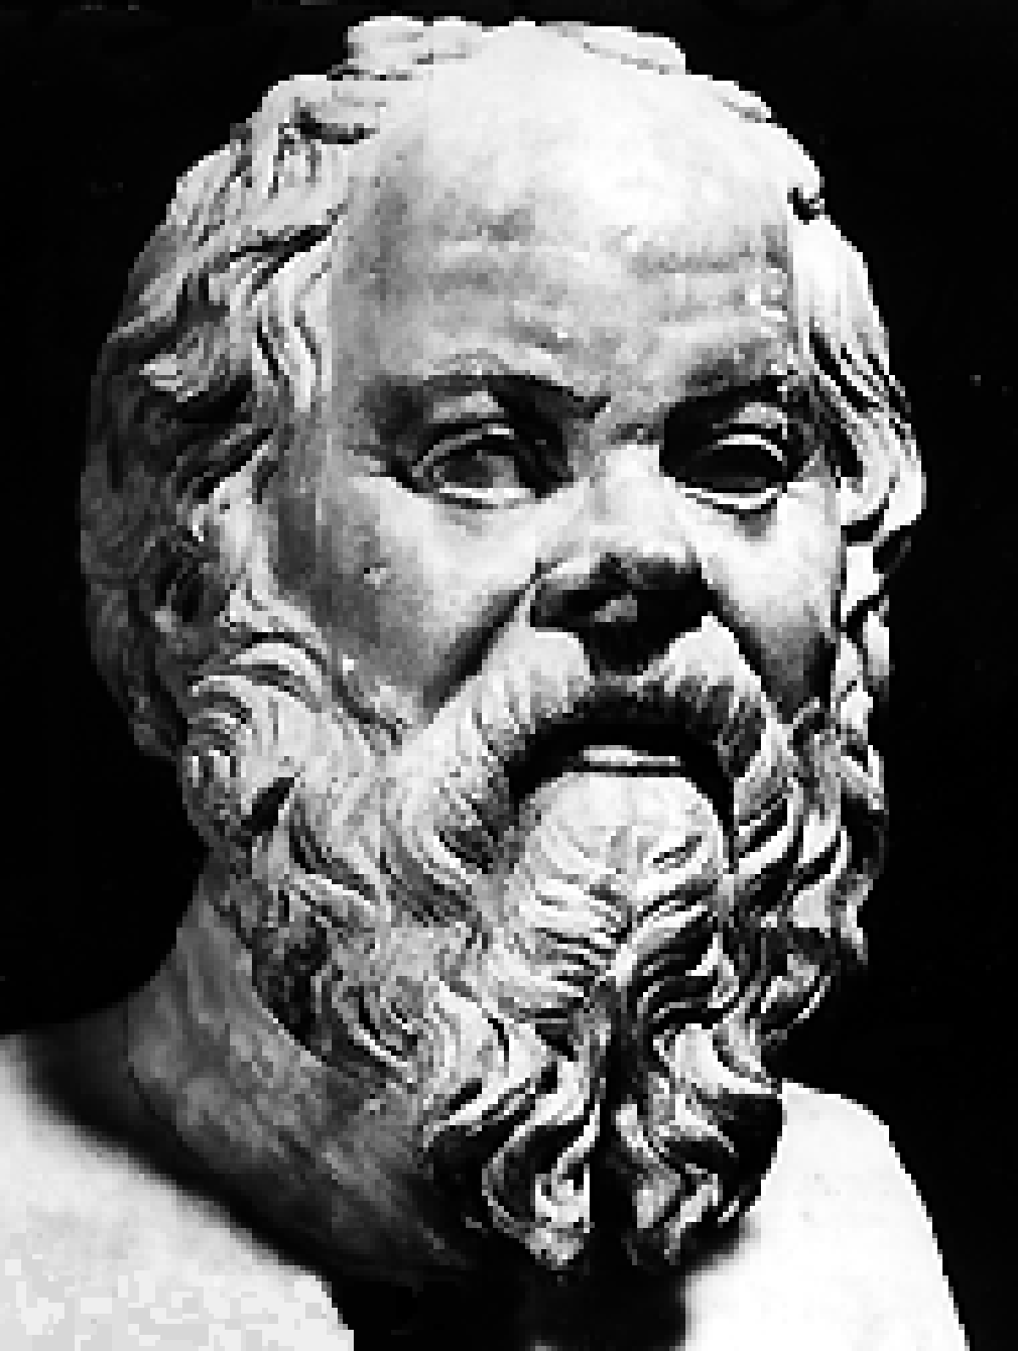
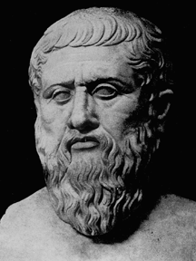
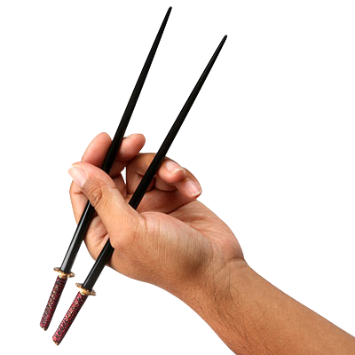
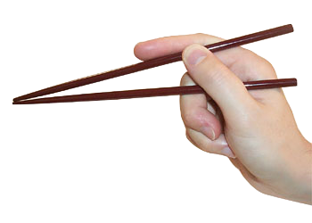
Dining Philosopher Problem

Slide 22
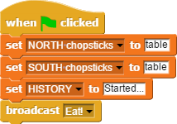
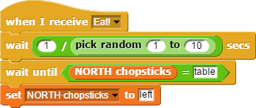
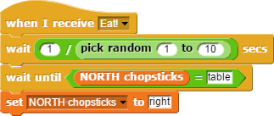
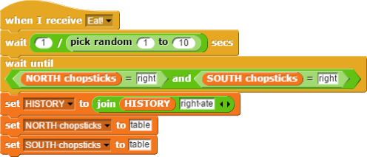

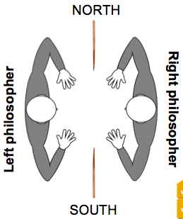
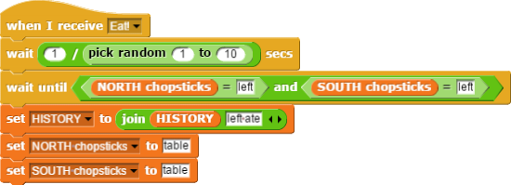
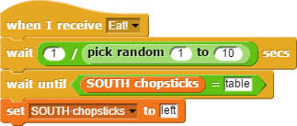
Question 12: Dining Philosophers (5 pts)
Two philosophers (left and right) are having dinner, sitting across from each other. There is a NORTH and a SOUTH chopstick on the table. Each philosopher continually looks down to see if a chopstick is on the table, and tries to grab it; if both are ever grabbed by one person, that person eats, updates HISTORY (a record of what happened) and puts the chopsticks down. Ten seconds after the green flag is clicked, what should HISTORY be?

Slide 23
Question 12: Dining Philosophers (5 pts)
Started…, Left ate…, Right ate…
Started…, Right ate…, Left ate…
Started…

